Slide 1
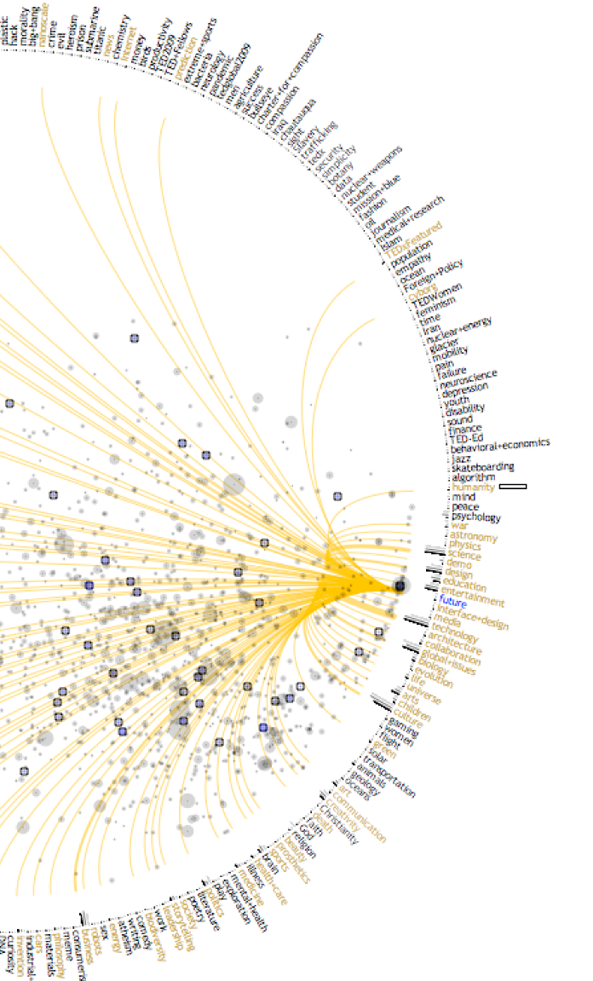
New Languages / Complex Types
A Samuel Pottinger
Stat 198: IDSV
Mar 10, 2025

Slide 2
Context Setting
Visualization as Representation
Visualization as Task
Visualization as Narrative
Visualization as Dialogue

Slide 3
Today
> Charts without names: Using dimensions, measures, and encodings to read a graphic.
More tips for complexity: Movements and levels
Group activity: Homework 11 in class!
Complex data: what non-CSV data inputs might look like.
Advice for maps: using the first perspective to navigate maps.

Slide 4
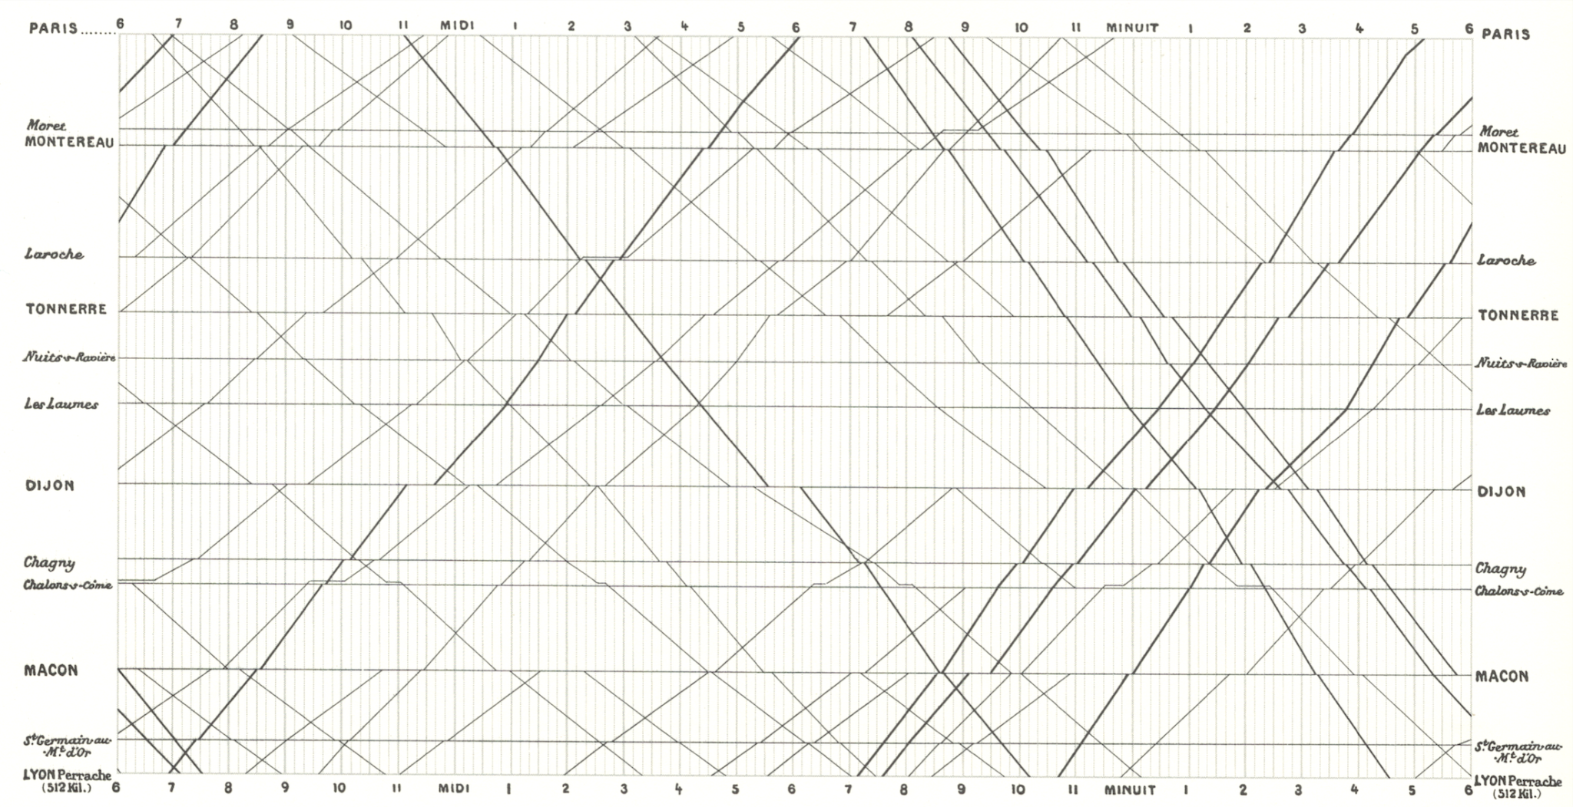
Charts without names - Marey

Slide 5
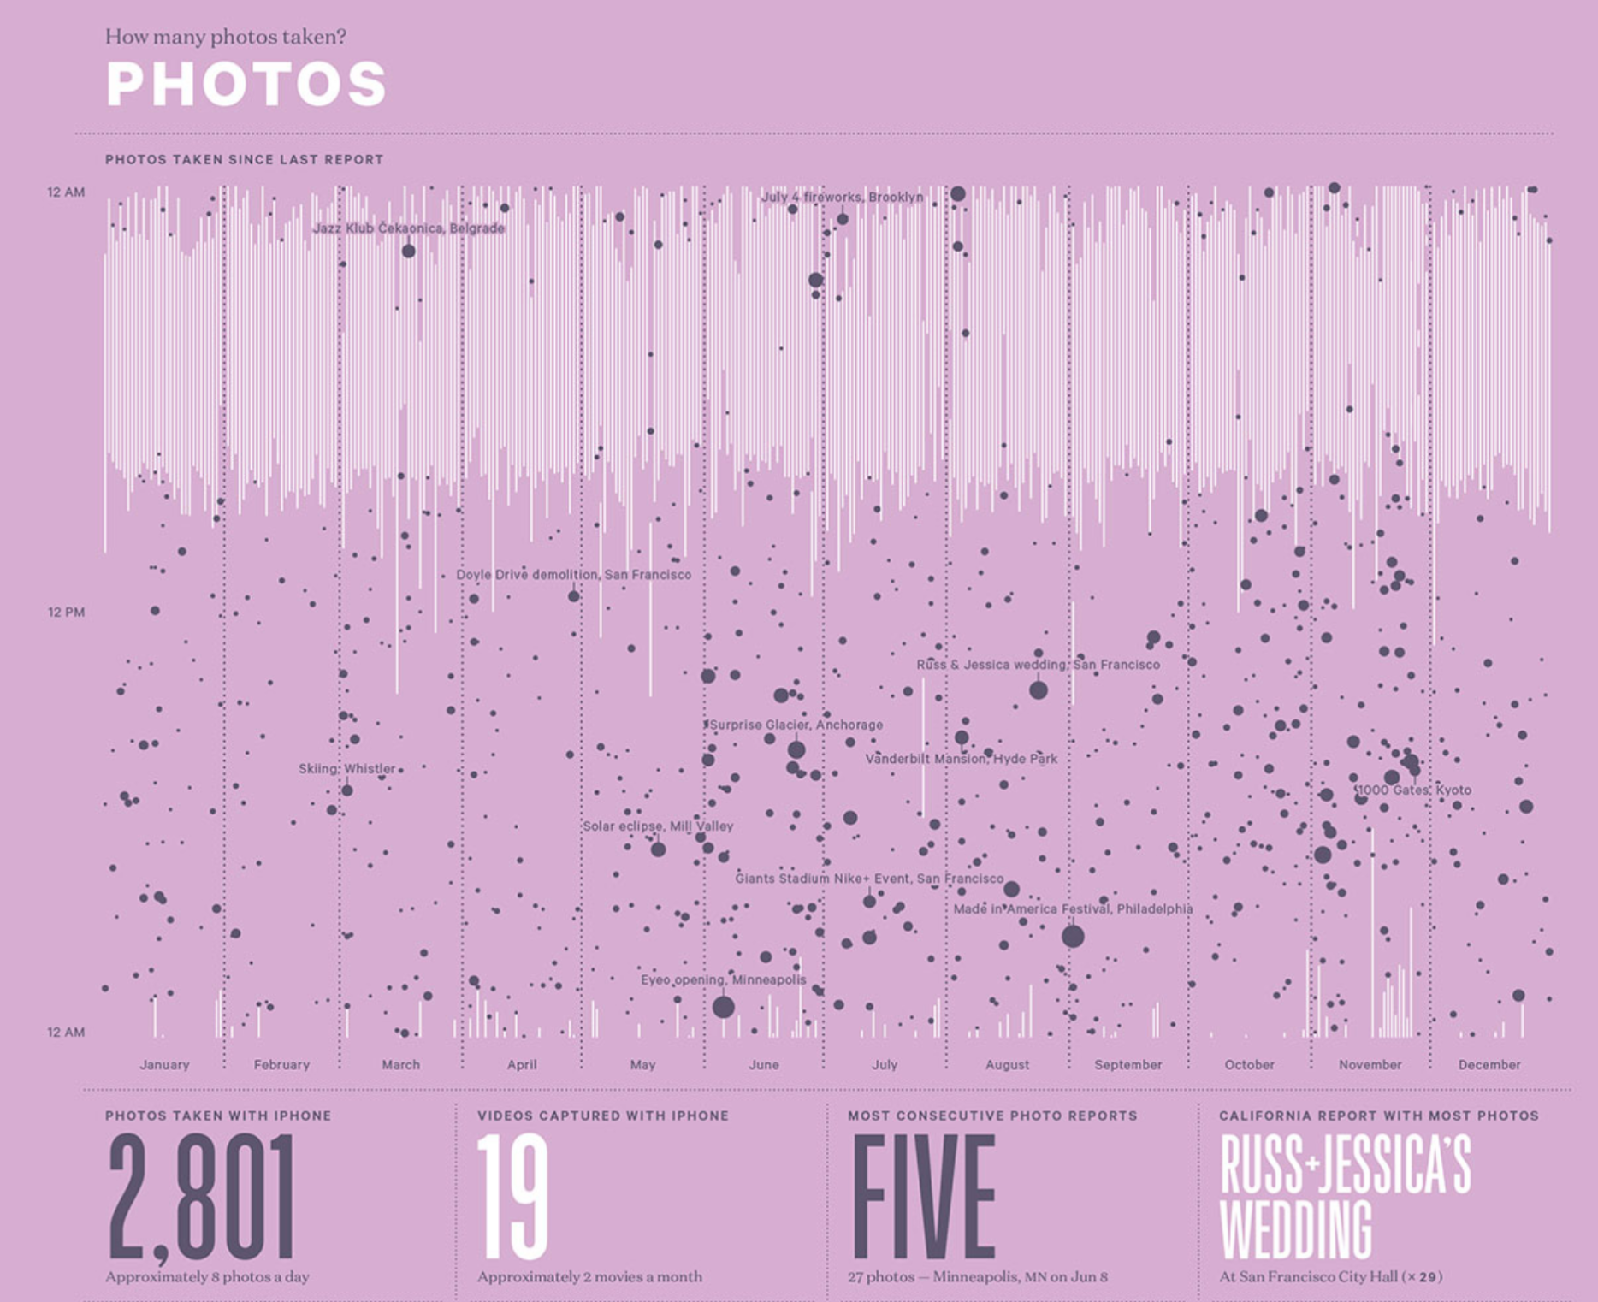
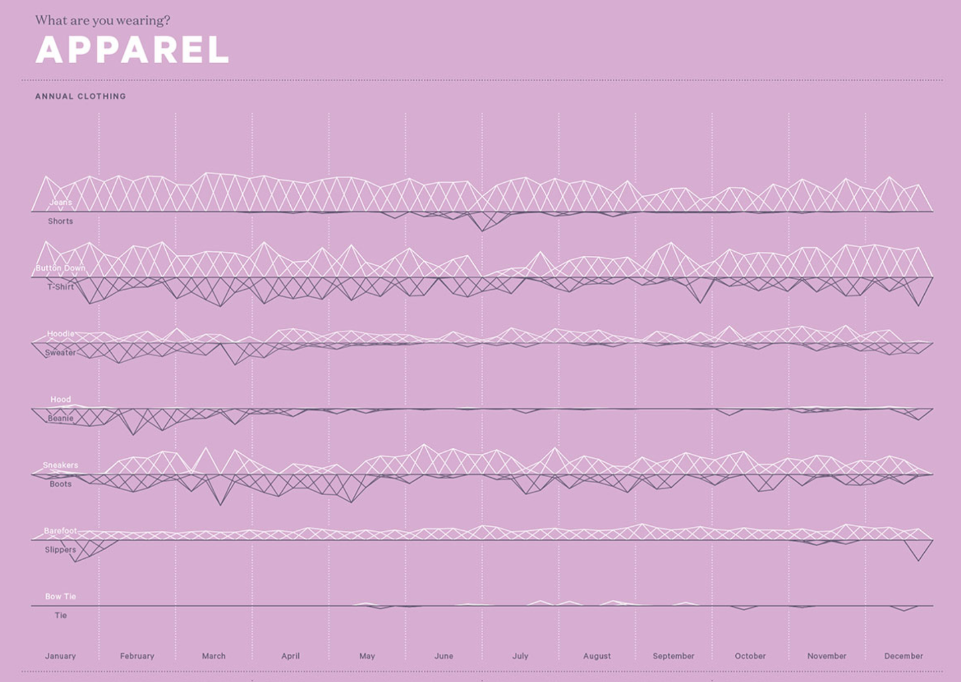
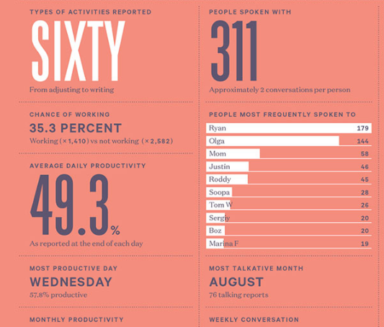
Charts without names - Felton

Slide 6

Charts without names - Minard

Slide 7
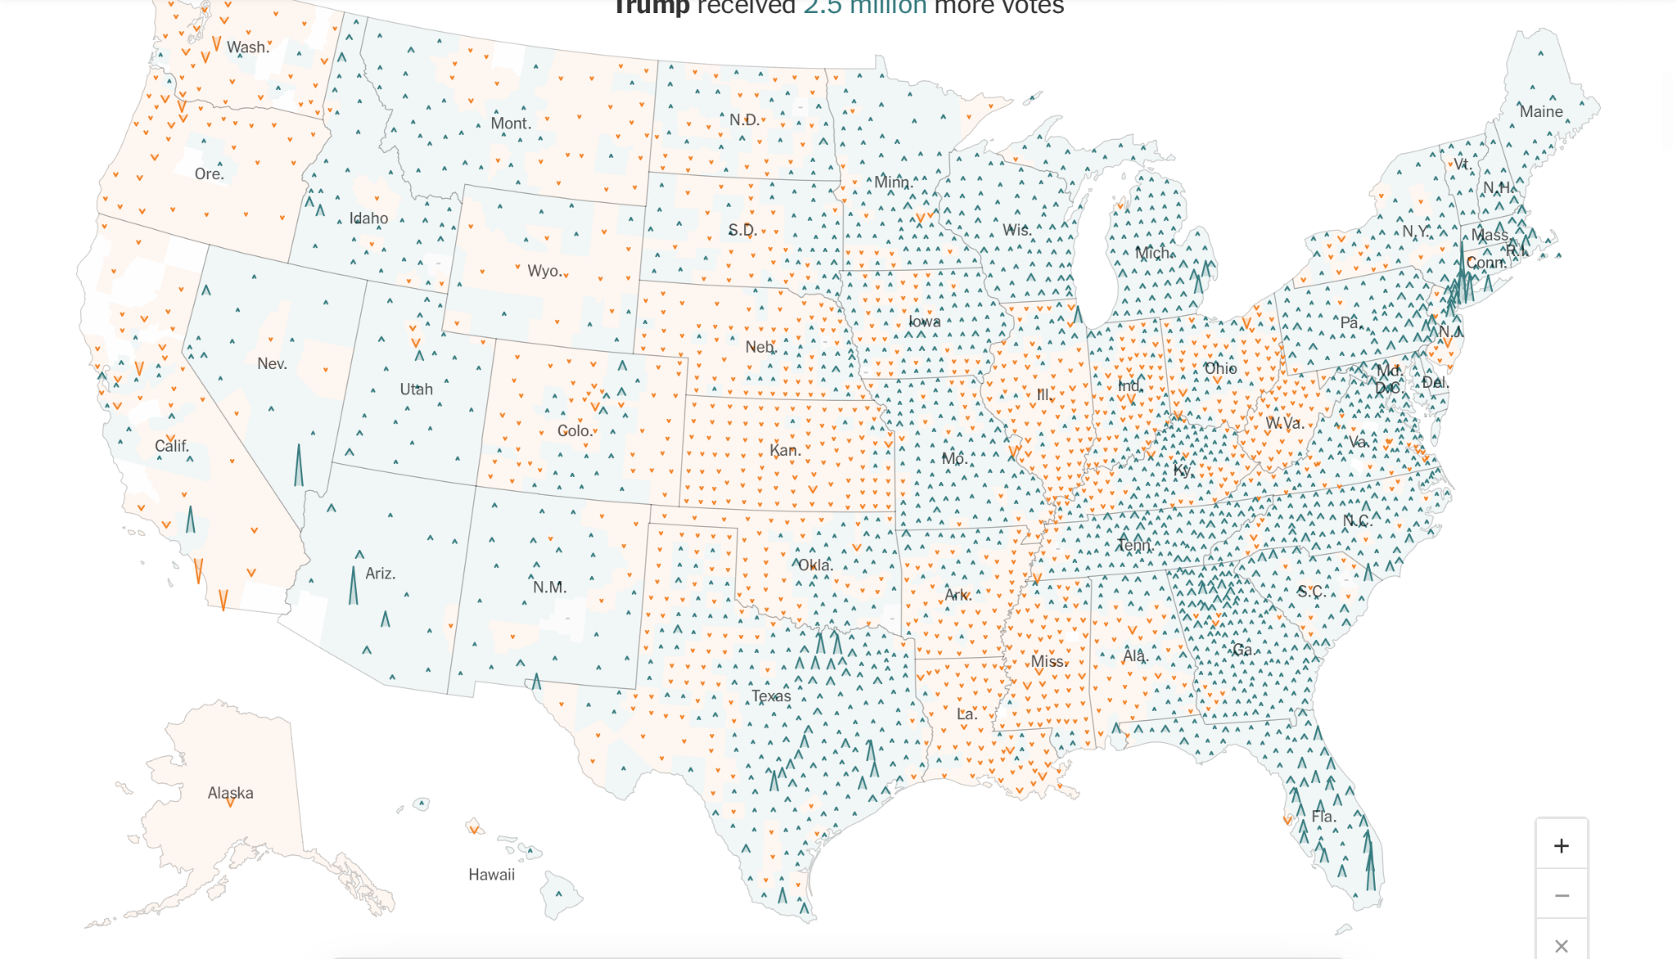
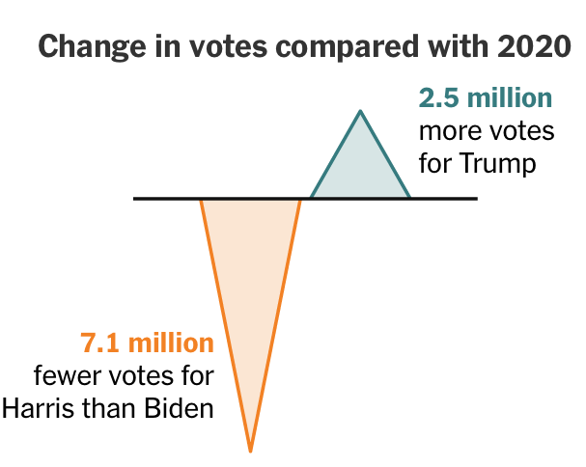
Charts without names - NYT

Slide 8
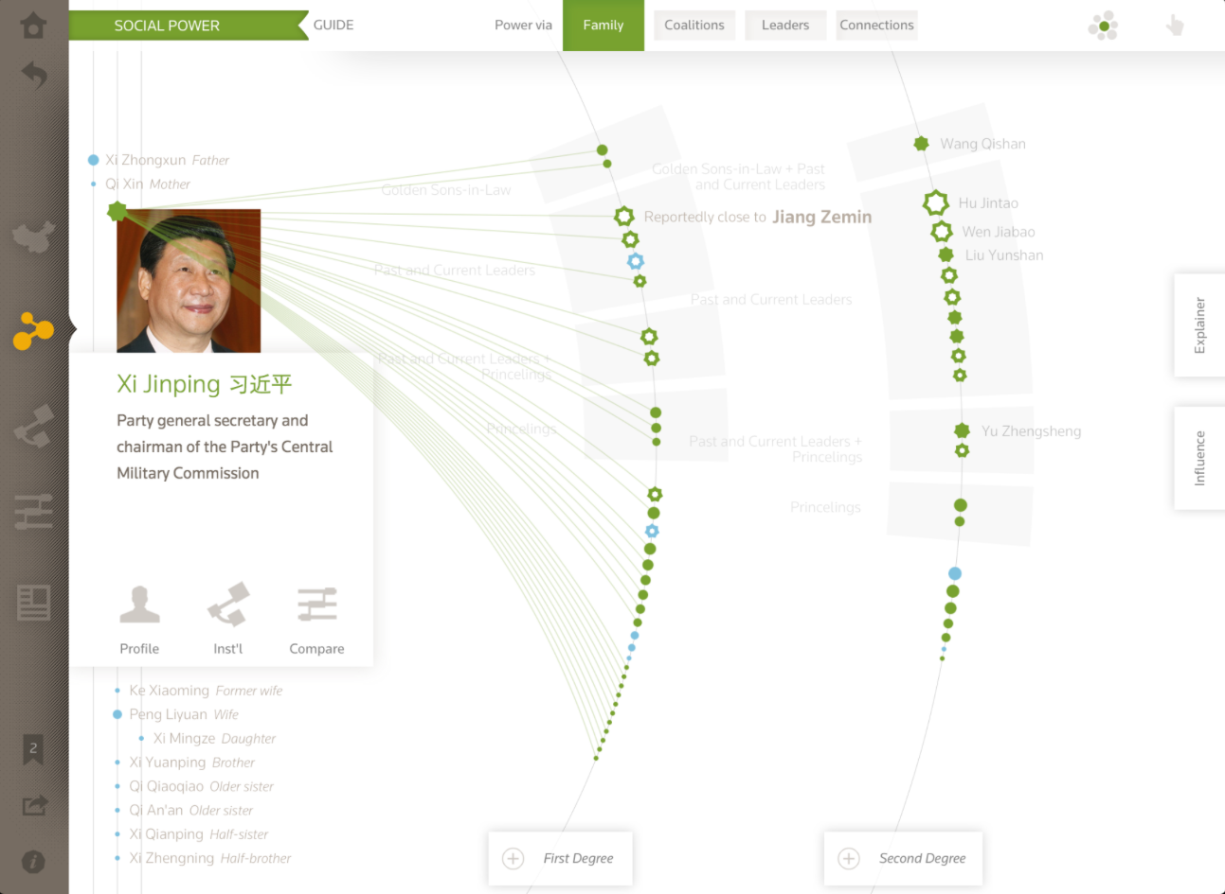
Charts without names - Fathom

Slide 9
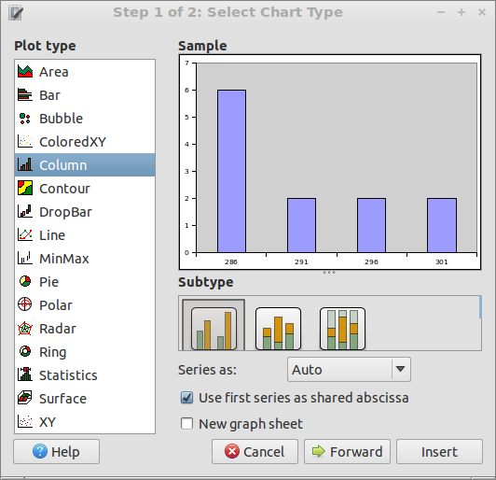
Charts without names
Instead of thinking in chart names, think in encodings.
What are the dimensions and measures?
How can I map those to encoding devices?

Slide 10
Today
Charts without names: Using dimensions, measures, and encodings to read a graphic.
> More tips for complexity: Movements and levels
Group activity: Homework 11 in class!
Complex data: what non-CSV data inputs might look like.
Advice for maps: using the first perspective to navigate maps.

Slide 11
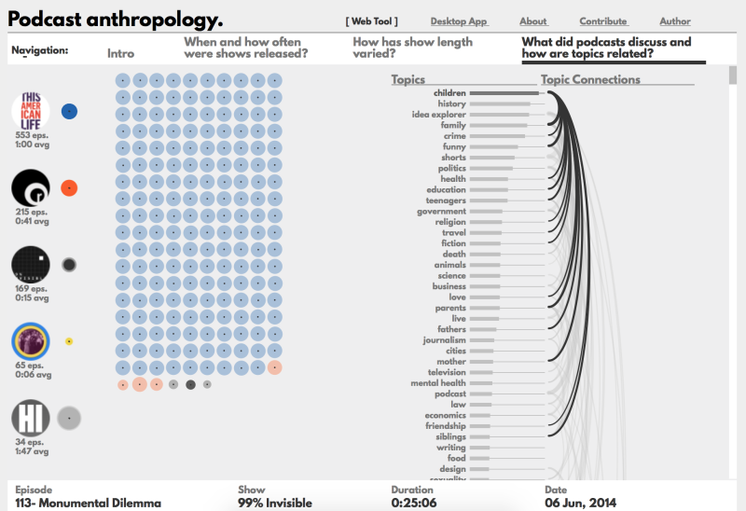
Movements
Podcast Anthropology

Slide 12
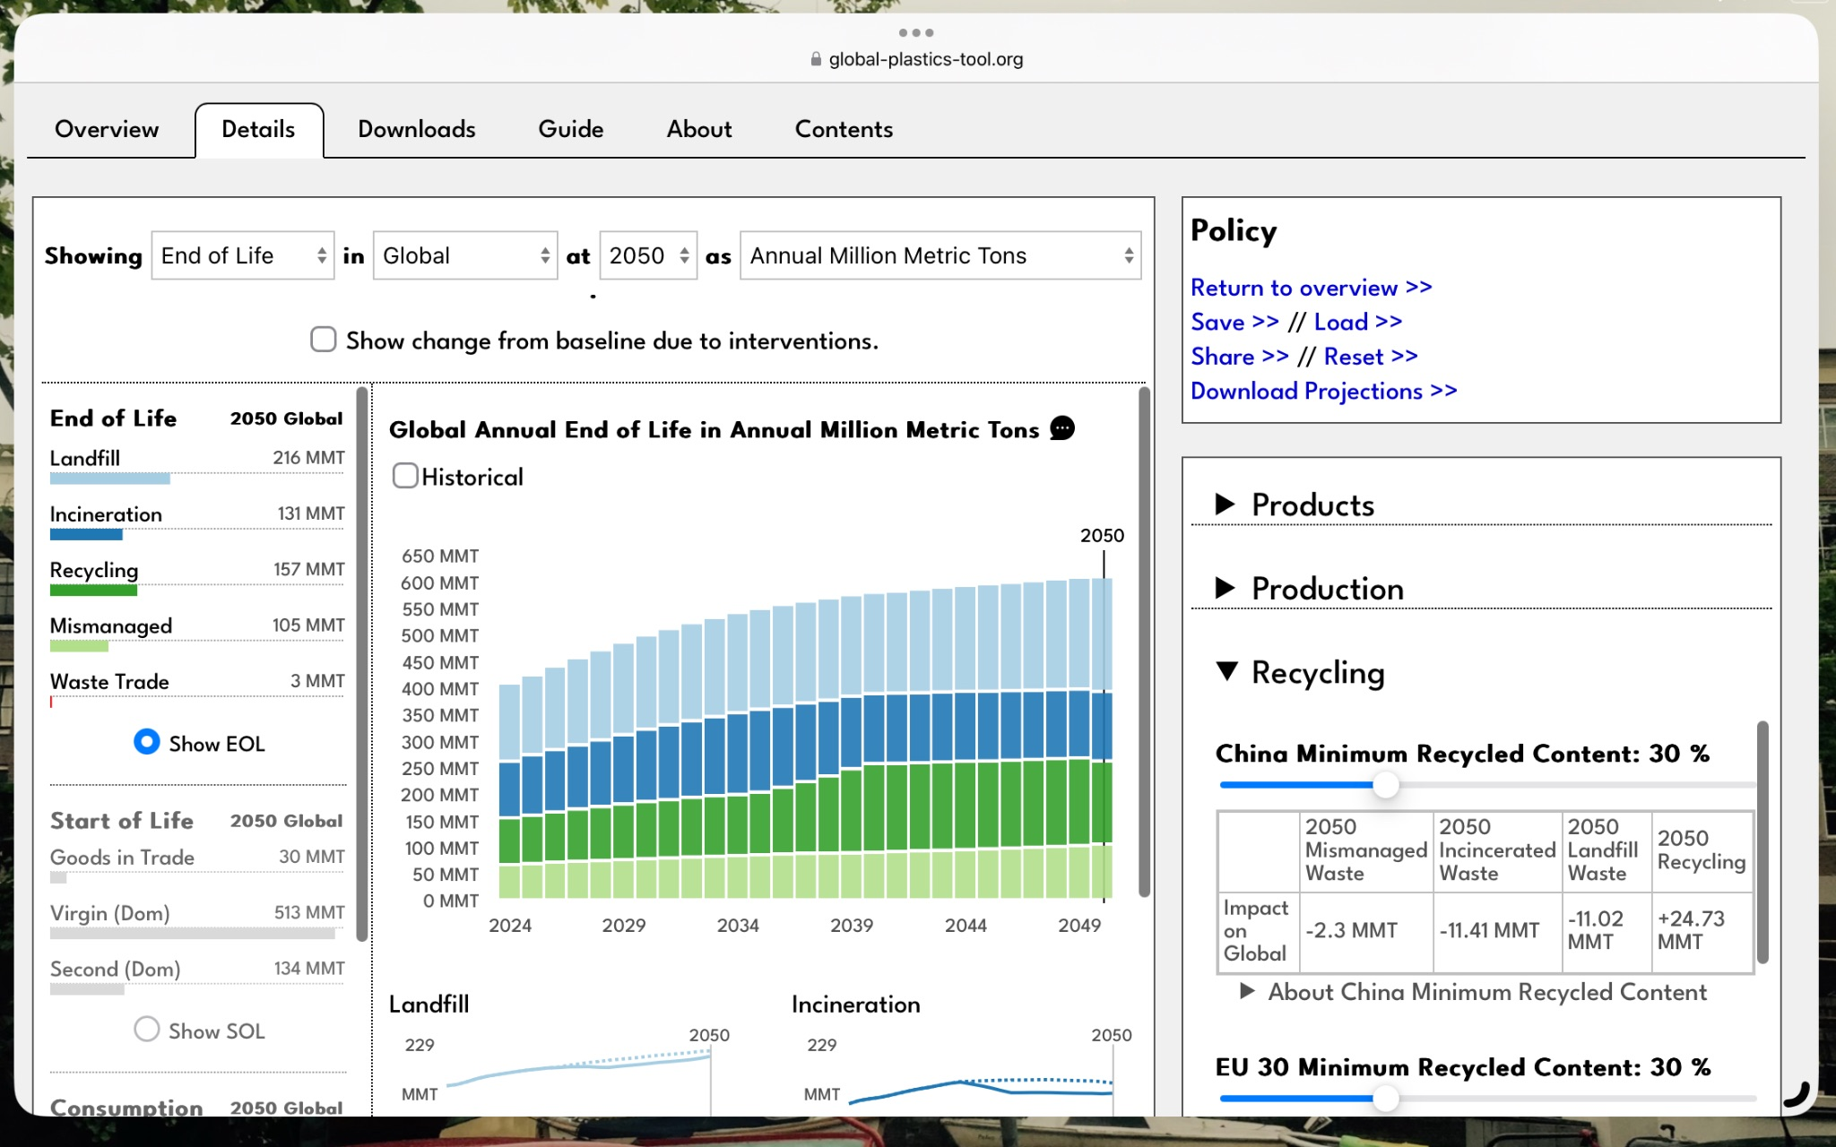
Levels
Global Plastics Tool

Slide 13
Two new tools
Movements: Reuse visual motifs or graphical representations across multiple plots to create a story between them. (Jonathan Harris)
Levels: Start with very simple graphics but, as the user spends more time interacting, add in more sophistication (Ben Fry)

Slide 14
Today
Charts without names: Using dimensions, measures, and encodings to read a graphic.
More tips for complexity: Movements and levels
> Group activity: Homework 11 in class!
Complex data: what non-CSV data inputs might look like.
Advice for maps: using the first perspective to navigate maps.

Slide 15
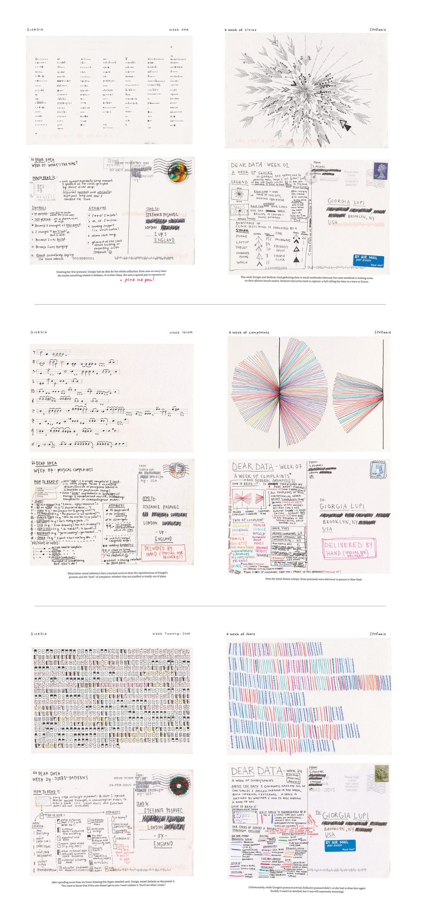
Dear Data
Draw (by hand with a pen, no code) your last five years and your next five years.

Slide 16
Today
Charts without names: Using dimensions, measures, and encodings to read a graphic.
More tips for complexity: Movements and levels
Group activity: Homework 11 in class!
> Complex data: what non-CSV data inputs might look like.
Advice for maps: using the first perspective to navigate maps.

Slide 17
Text formats
CSV
JSON
YAML
GeoJSON

Slide 18
We will do some work with GeoJSON
Name | Age | Friends
John Doe | 25 | Jane Doe, Jack Smith
Jane Doe | 27 | John Doe, Mary Sue
CSV

Slide 19
We will do some work with GeoJSON
{
“people”: [
{
“age” : 25,
“name”: “John Doe”,
“friends”: [“Jane Doe”, “Jack Smith”]
},
{
“age” : 27,
“name”: “Jane Doe”,
“friends”: [“John Doe”, “Mary Sue”]
}
]
}
JSON

Slide 20
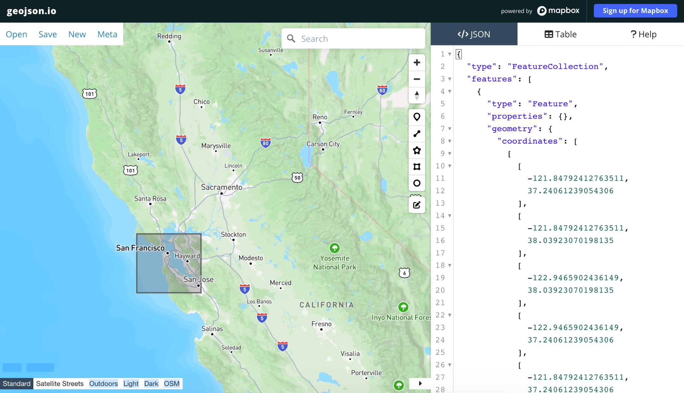
We will do some work with GeoJSON
GeoJSON
Mapbox, OSM

Slide 21
Binary formats
Protobuf
Avro
Arrow
Geotiff
Geobuf
GeoArrow
COG

Slide 22
Today
Charts without names: Using dimensions, measures, and encodings to read a graphic.
More tips for complexity: Movements and levels
Group activity: Homework 11 in class!
Complex data: what non-CSV data inputs might look like.
> Advice for maps: using the first perspective to navigate maps.

Slide 23
What makes maps hard - technically
NetCDF
GeoJSON
COG
GeoArrow
Geotiff
It is not uncommon to encounter geospatial datasets in the many gigabytes lots of formats
The “basemap” is also often very large.

Slide 24
What makes maps hard - from design
You almost always lose your best encoding device right away to vertical and horizontal position in space.
The basemap itself often includes substantial visual elements that an occlude the glyphs on top.
Mapbox, OSM

Slide 25
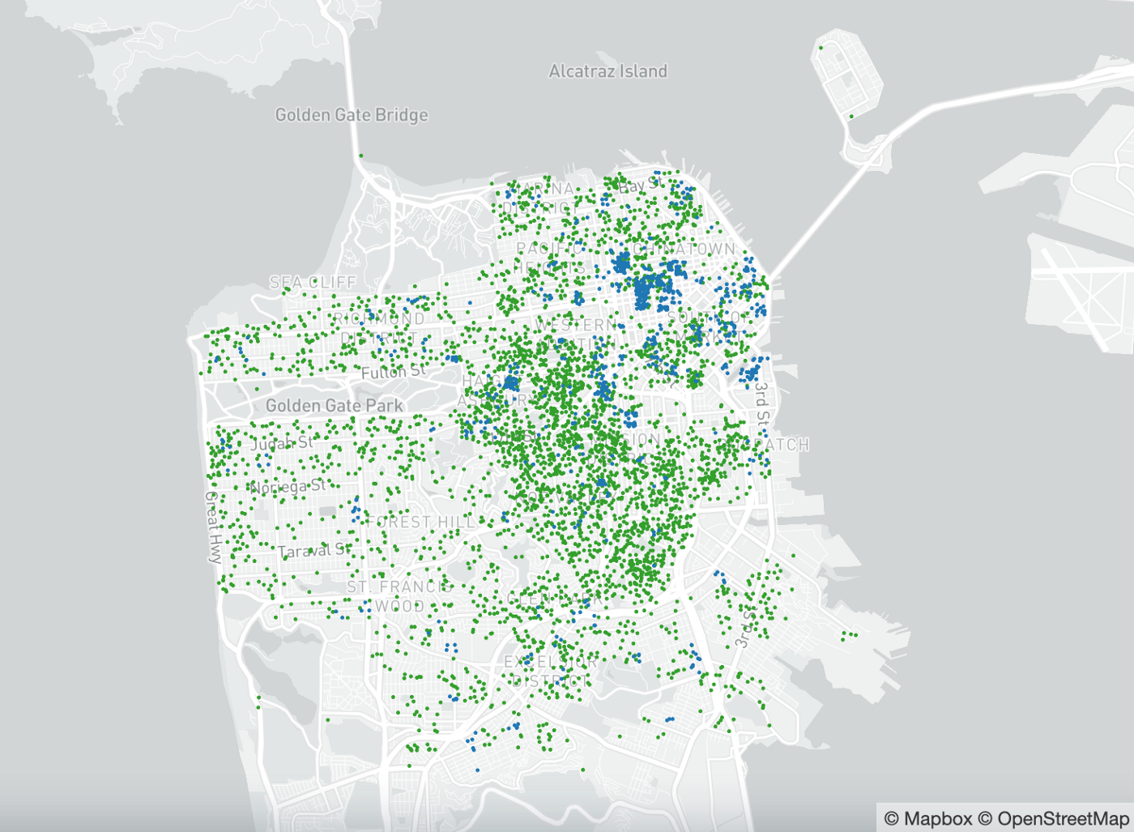
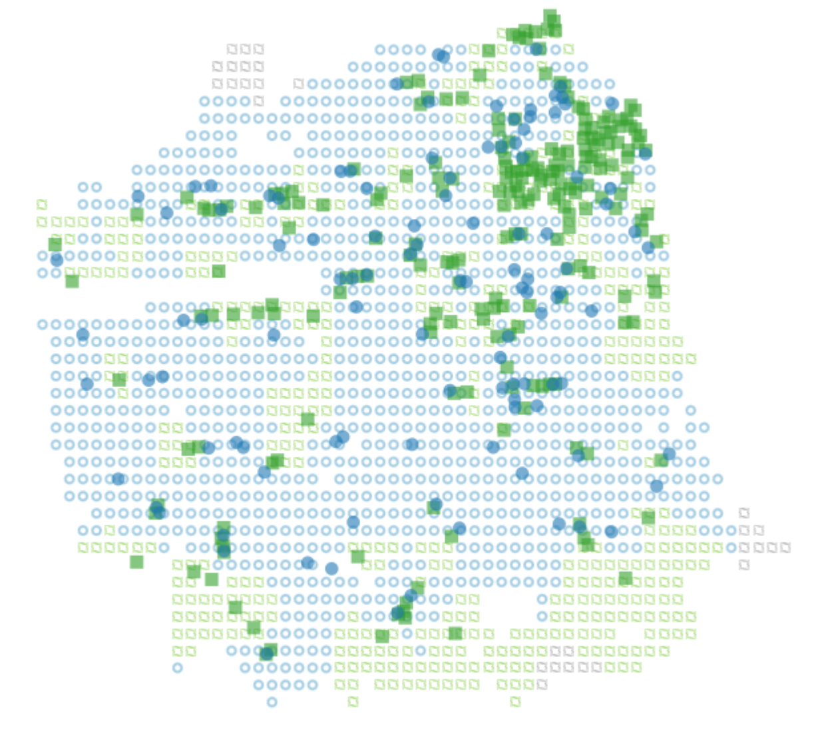
Applying our advice - preattentive features
Keep a focus on things that will pop: shape, form, color.

Slide 26
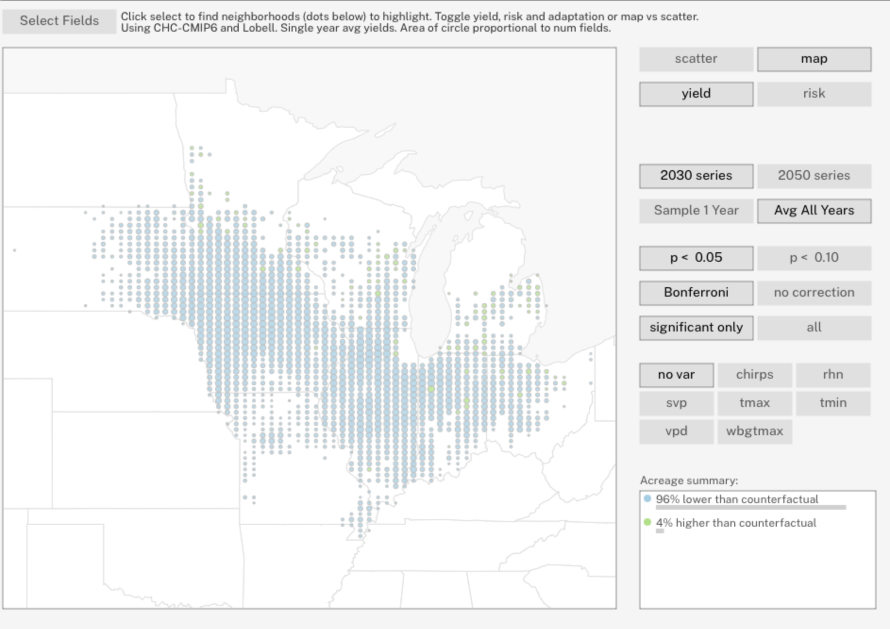
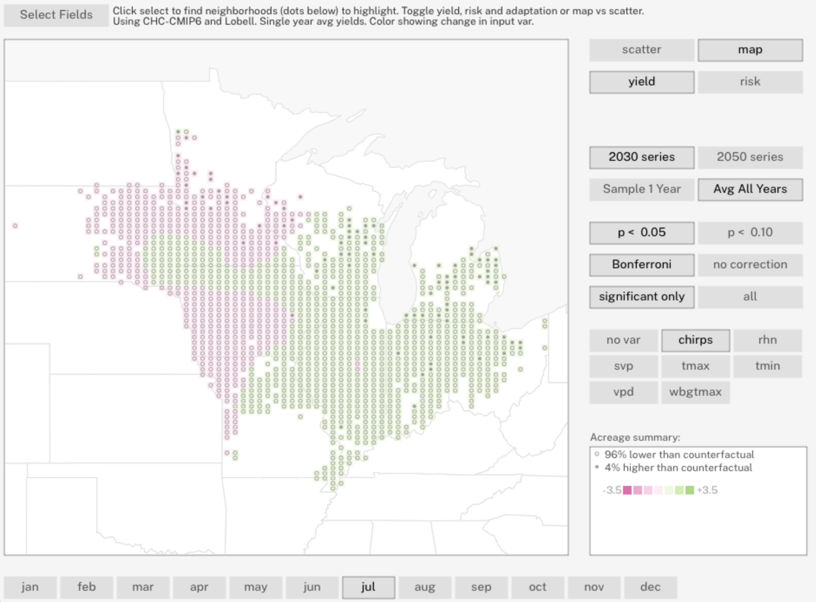
Applying our advice - valuable encoding devices
Consider area for depicting small details
Consider color for things where there are very large differences.

Slide 27
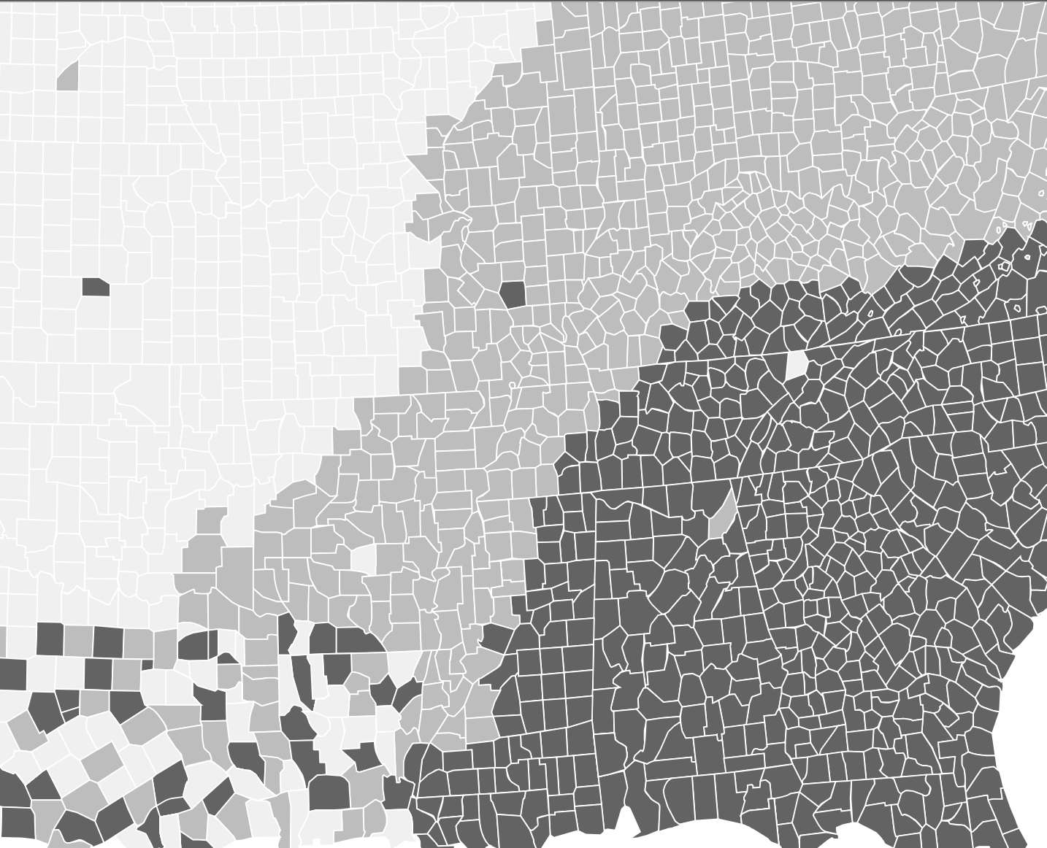
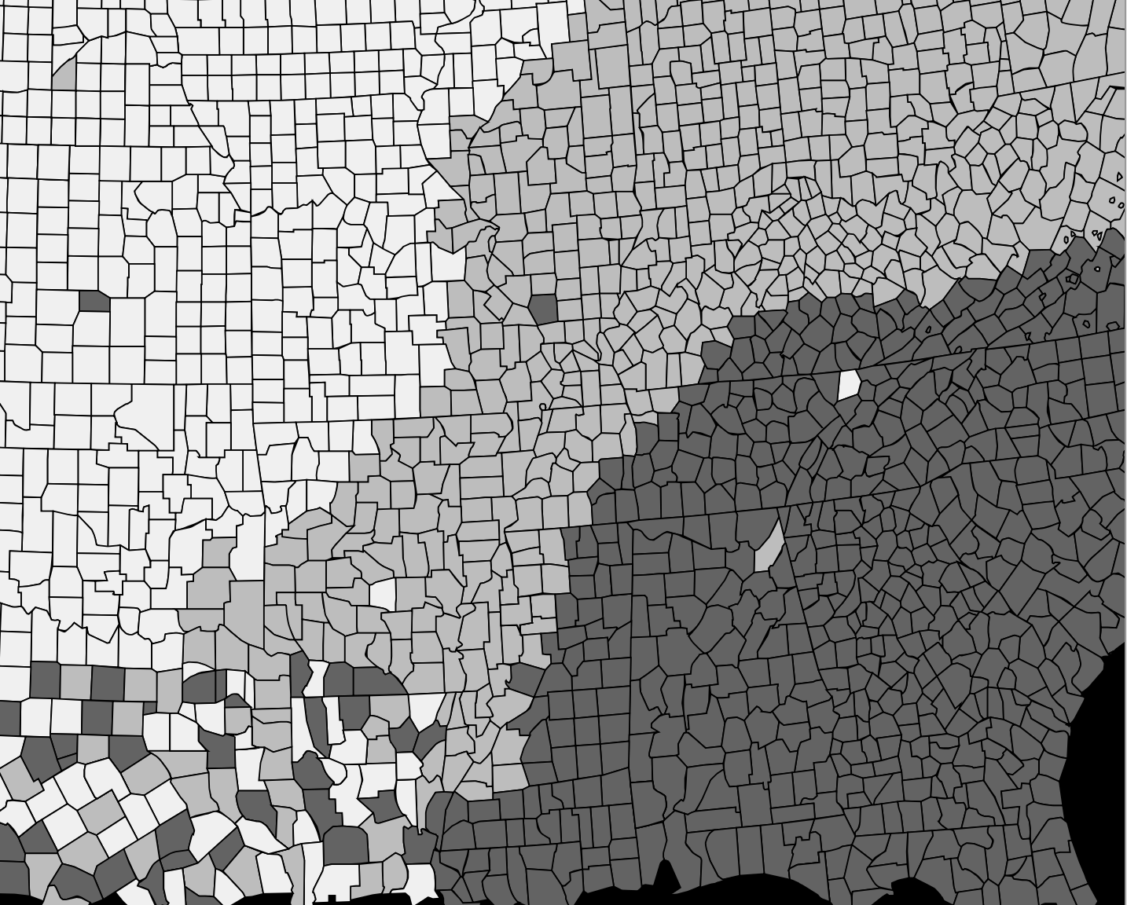
Applying our advice - quantitative color scales
Focus on contrast against background to create strong figure / ground.

Slide 28
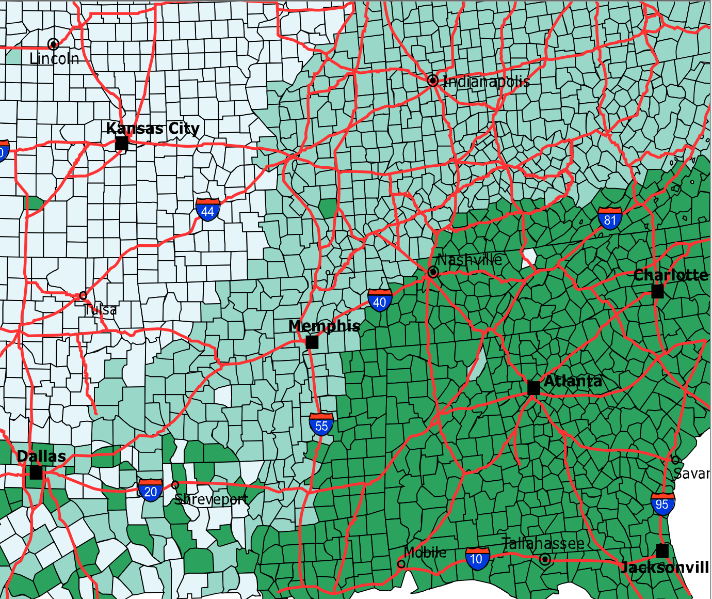
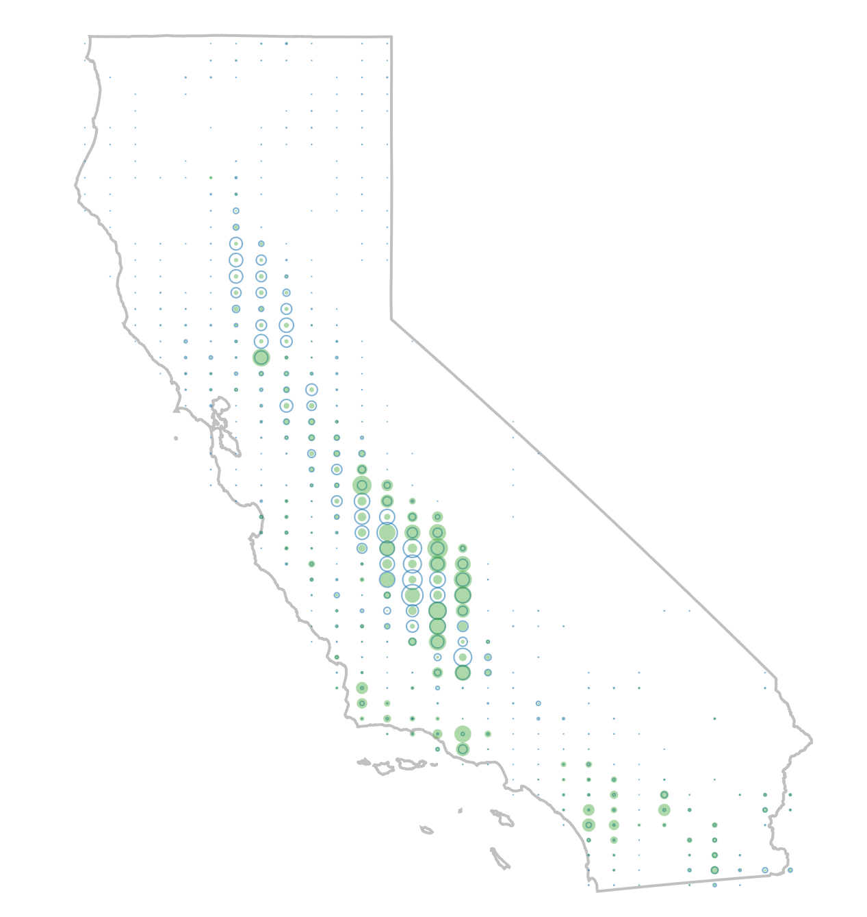
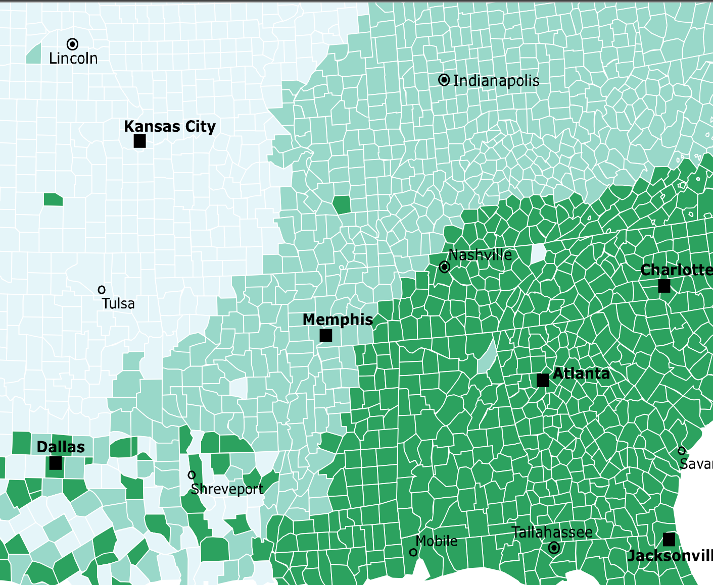
Applying our advice - keep channels clear

Slide 29
Applying our advice - focus on the user
Teaser for the next lecture -
If we narrow our focus by understanding the user and their tasks, maybe not all of the data are relevant?

Slide 30
Other complex data: networks
There’s more advice on networks. See the reading!

Slide 31
Citations
B. Adhikari, "Marey's train schedule," University of Missouri Saint Louis, 2021. Available: https://badriadhikari.github.io/data-viz-workshop-2021/minards/
N. Felton, "2012 Annual Report," Feltron, 2013. Available: https://feltron.com/FAR12.html.
J. Cheng, “Analyzing Minard's Visualization Of Napoleon's 1812 March,” ThoughtBot, 2014. Available: https://thoughtbot.com/blog/analyzing-minards-visualization-of-napoleons-1812-march
A. Wu, L. Gamio, R. Gebeloff, E. Shao, and M. Bender, “Key to Trump’s Win: Heavy Losses for Harris Across the Map,” New York Times Company, 2024. Available: https://www.nytimes.com/interactive/2024/11/19/us/politics/voter-turnout-election-trump-harris.html
Fathom Information Design, “Connected China,” Thomson Reuters. Available: https://fathom.info/china/
D. Ling, “Introduction to Statistics Using LibreOffice.org Calc, Apache OpenOffice.org Calc, and Gnumeric,” Comfsm, Available: http://www.comfsm.fm/~dleeling/statistics/text5.html
Fathom Information Design, “No Ceilings”, The Clinton Foundation and The Bill and Melinda Gates Foundation. Available: https://noceilings.org/
A. Pottinger, “Podcast Anthropology,” Gleap, 2025. Available: http://podcastanthropology.com/
B. Fry, “Audience & Context,” Eyeo, 2015. Available: https://vimeo.com/133608686?embedded=true&source=vimeo_logo&owner=8053320

Slide 32
Citations
Geojson.io, “Geojson.io,” Mapbox. Available: https://geojson.io/
A. Pottinger, L. Connor, B. Guzder-Williams, M. Weltman-Fahs, and T. Bowles. “Climate-Driven Doubling of U.S. Maize Loss Probability,” Preprint, 2024. Available: https://ag-adaptation-study.pub
A. Pottinger, “SF AirBnB Analysis,” Towards Data Science, Available: https://gleap.org/content/airbnb
A. Pottinger, “California Crop Shift Simulation,” University of California, 2024. Available: ”https://crop-shift-sampottinger3-2860.replit.app/
A. Pottinger, “Food Sim SF,” Gleap, 2024. Available: https://foodsimsf.com/
S. Kamvar and J. Harris, “We Feel Fine and Searching the Emotional Web,” Proceedings of the fourth ACM international conference on Web search and data mining, 2011. Available: https://www.wefeelfine.org/wefeelfine.pdf
A. Pottinger, “TED Visualization,” Gleap, 2012. Available: https://gleap.org/content/ted_visualization

Slide 33


